Slide 1


Slide 2
Lecture By Arjun Pukale

Slide 3

Regularization

Slide 4
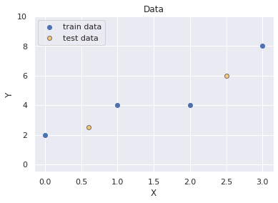
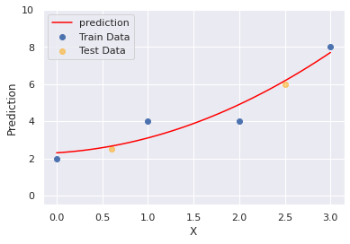
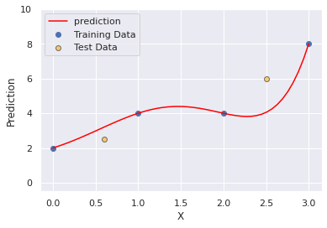

Understanding the problem of Overfitting
Original Data
Ideal Fit
Over Fit

Slide 5
Understanding the problem of Overfitting
Original Data
Ideal Fit
Over Fit
What if w1, w2 = 0 ?

Slide 6

Understanding the problem of Overfitting
Original Data
Ideal Fit
Over Fit
What if w1, w2 = 0 ?

Slide 7
Understanding the problem of Overfitting
Original Data
Ideal Fit
Over Fit
What if w1, w2 = 0 ?
Ideal Fit!!!

Slide 8
Understanding the problem of Overfitting
Original Data
Ideal Fit
Over Fit
But How the model will do this by its own?
What if w1, w2 = 0 ?
Ideal Fit!!!

Slide 9
Regularization

Slide 10
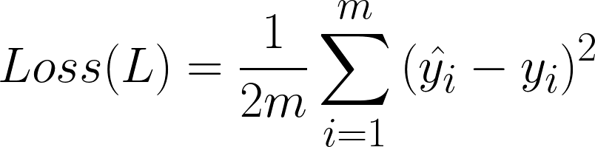
Regularization
Our Loss Function:

Slide 11
Regularization
Our Loss Function:

Slide 12
Regularization
Our Loss Function:

Slide 13
Regularization
Our Loss Function:
To Minimize the Loss: w1=w2≈0

Slide 14

Regularization
Our Loss Function:
To Minimize the Loss: w1=w2≈0
In General:

Slide 15
Regularization
Our Loss Function:
To Minimize the Loss: w1=w2≈0
In General:
where, λ is a hyperparameter which can be tuned to get best result

Slide 16
Regularization
Our Loss Function:
To Minimize the Loss: w1=w2≈0
In General:
where, λ is a hyperparameter which can be tuned to get best result
Trade off between Squared error and Magnitude of weights

Slide 17
Regularization
Our Loss Function:
To Minimize the Loss: w1=w2≈0
In General:
L2 Regularization
where, λ is a hyperparameter which can be tuned to get best result
Trade off between Squared error and Magnitude of weights

Slide 18

Regularization
Our Loss Function:
To Minimize the Loss: w1=w2≈0
In General:
L1 Regularization
where, λ is a hyperparameter which can be tuned to get best result
Trade off between Squared error and Magnitude of weights

Slide 19
λ

Slide 20
λ ≥ 0
if λ = 0: No Regularization
High λ => High Regularization (Increasing Bias)
Low λ => Low Regularization

Slide 21
λ ≥ 0
if λ = 0: No Regularization
High λ => High Regularization (Increasing Bias)
Low λ => Low Regularization
So, How to find the best value of λ ???

Slide 22
λ ≥ 0
if λ = 0: No Regularization
High λ => High Regularization (Increasing Bias)
Low λ => Low Regularization
So, How to find the best value of λ ???
Divide the dataset into
Train and Test/validation data

Slide 23
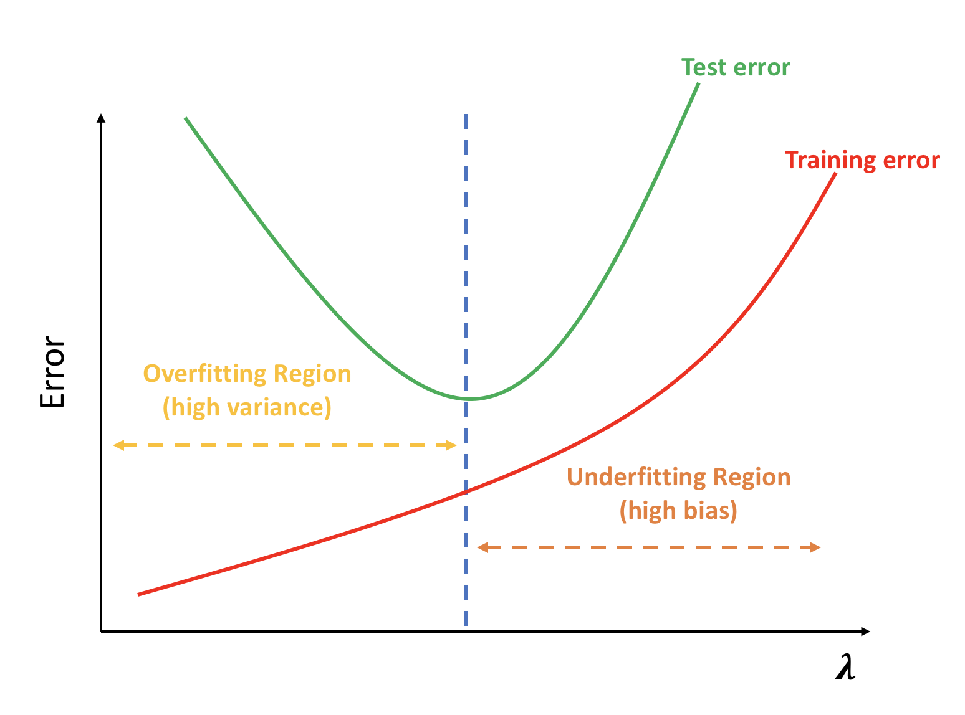
λ ≥ 0
if λ = 0: No Regularization
High λ => High Regularization (Increasing Bias)
Low λ => Low Regularization
So, How to find the best value of λ ???
Divide the dataset into
Train and Test/validation data

Slide 24



